Slide 1
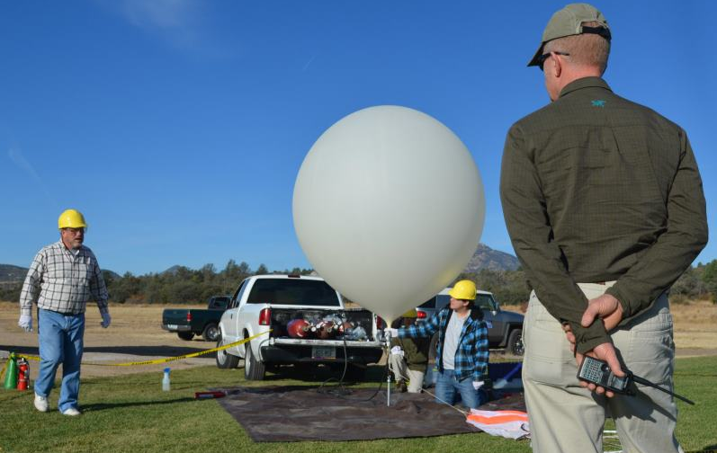
Improvements And Maintenance Of Hi-Ball Automated Position Reporting Beacons

Slide 2
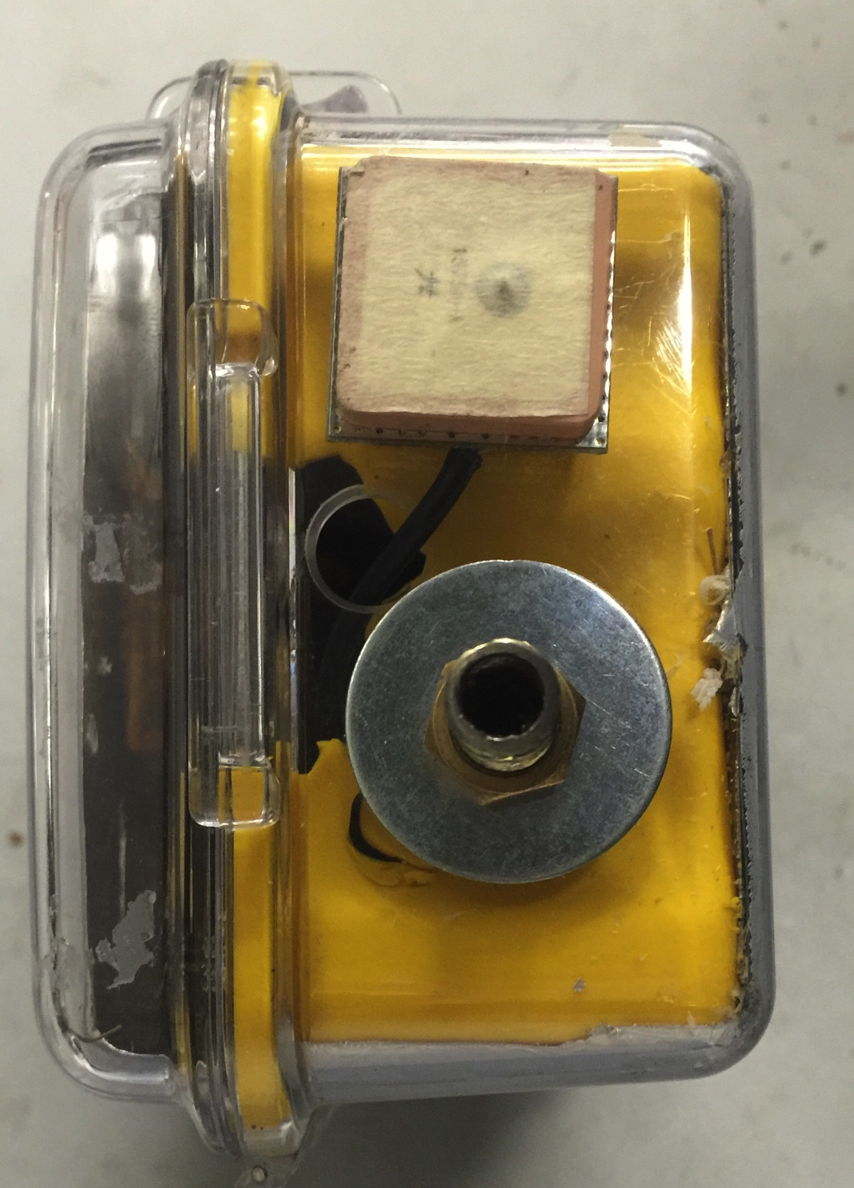
Improvements
Impact resistance
Decreased weight
Antenna ground

Slide 3
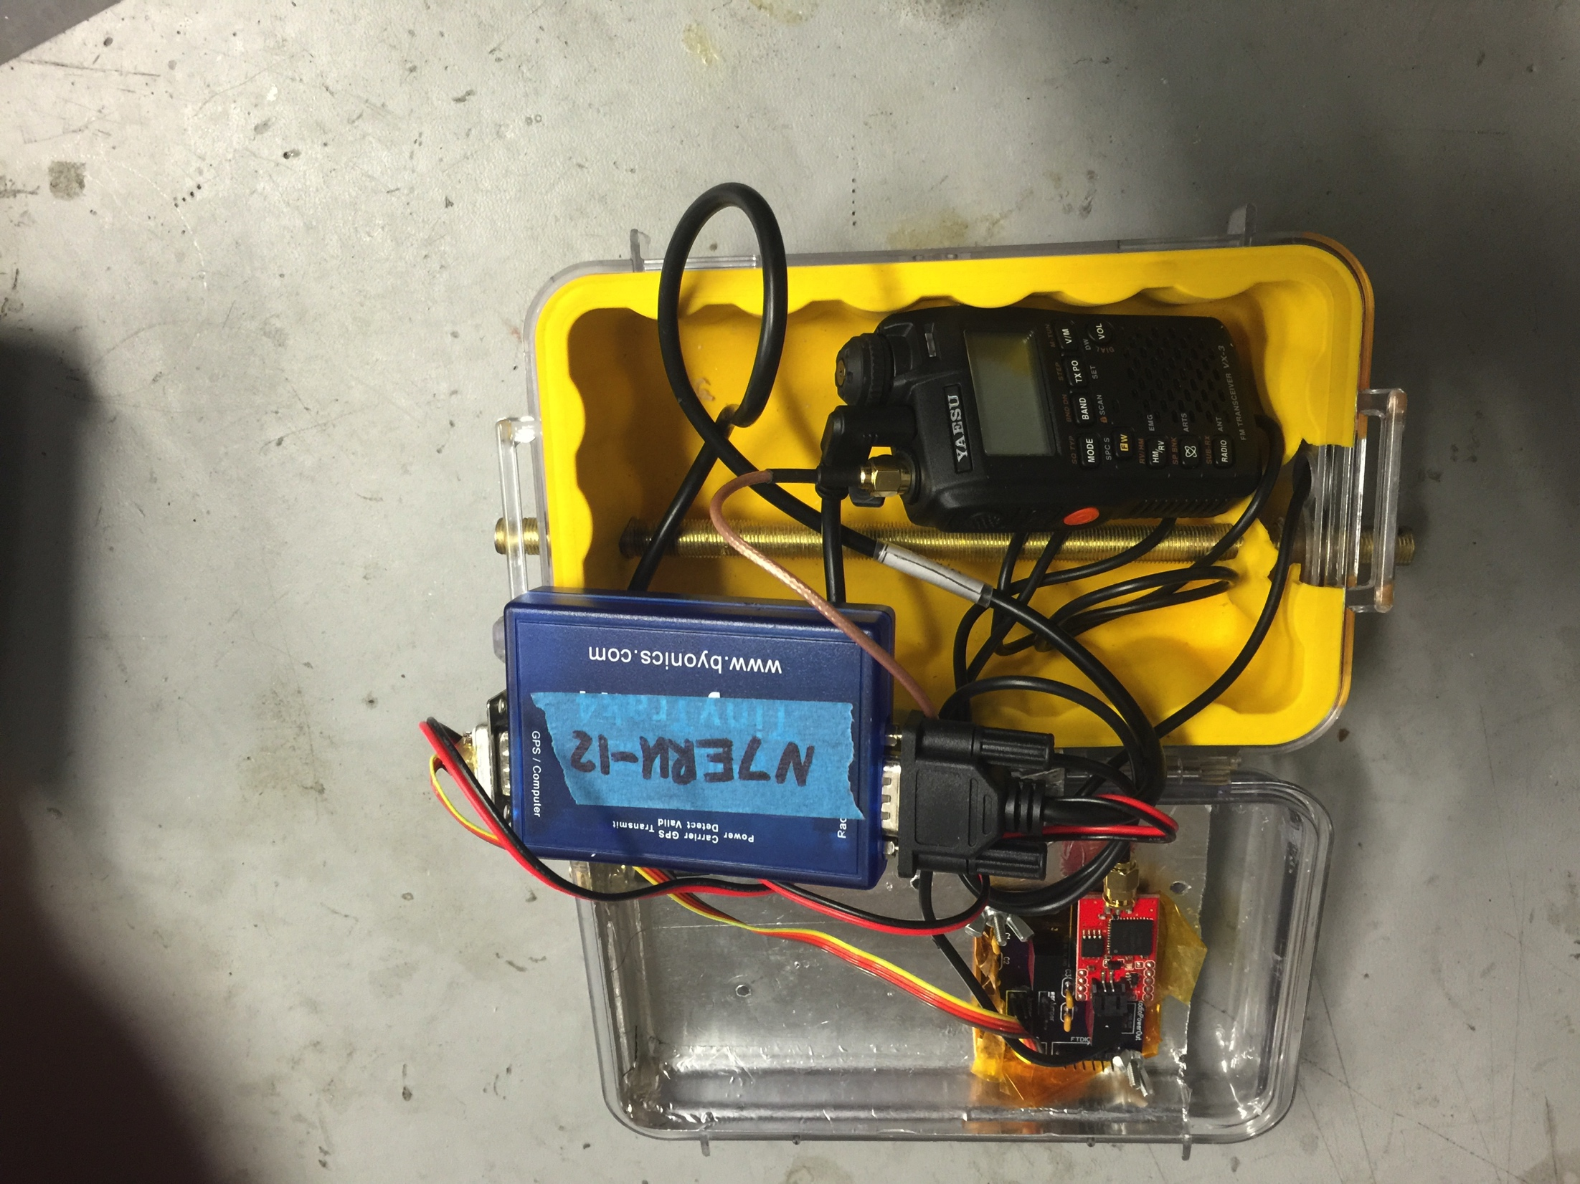
Impact Resistance
Component Layout
More Clearance
Notes:
Things don’t hit each other on impact

Slide 4
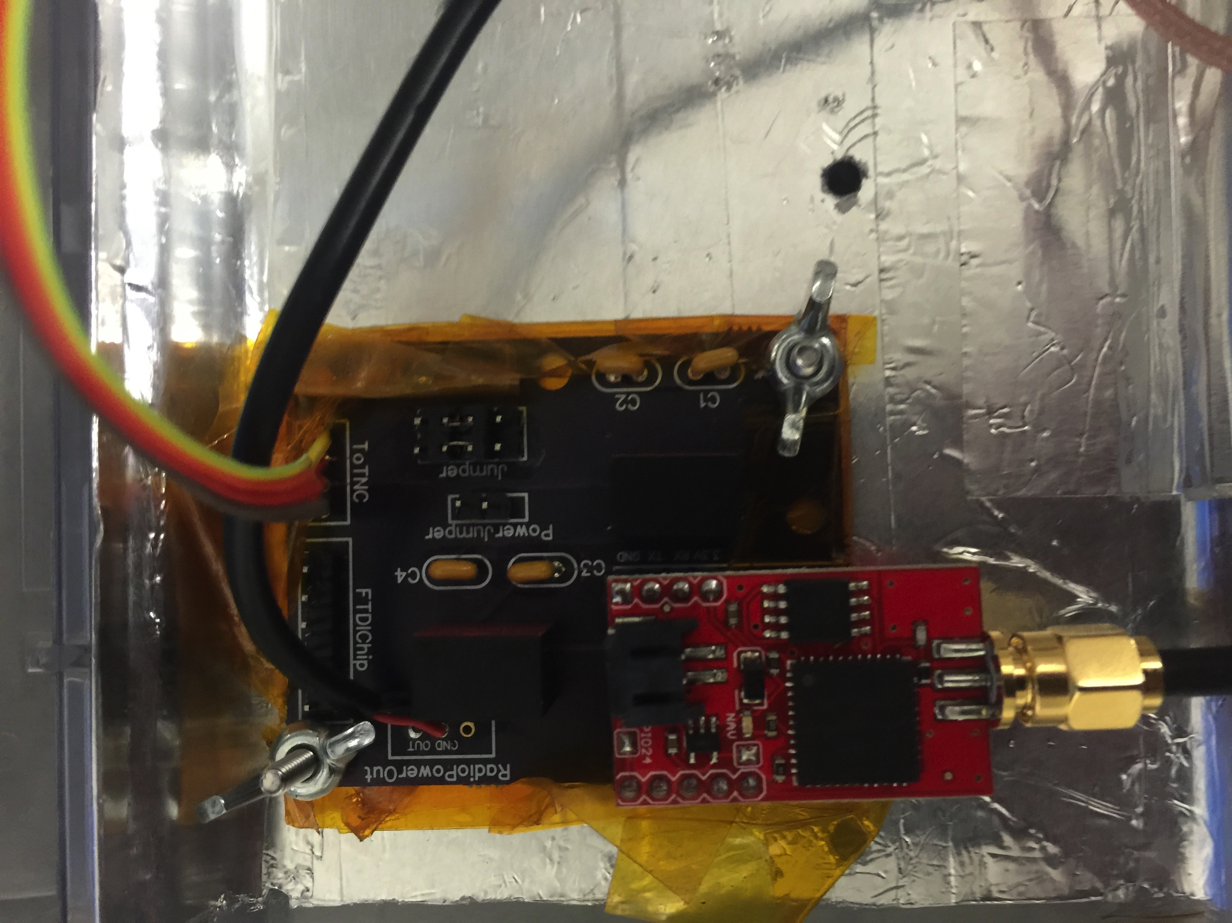
Decreased Weight
Smaller Battery
Redesigned PCB
Notes:
Smaller battery, fewer components

Slide 5
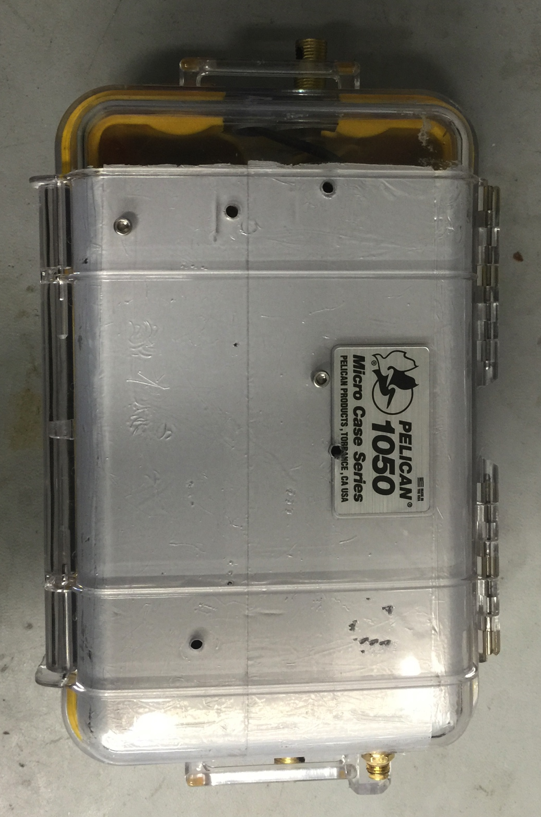
Antenna Grounding
Foil Tape
Drilling into pelican case
BNC connectors

Slide 6
Maintenance
Check functionality
New Antenna
Repairs

Slide 7
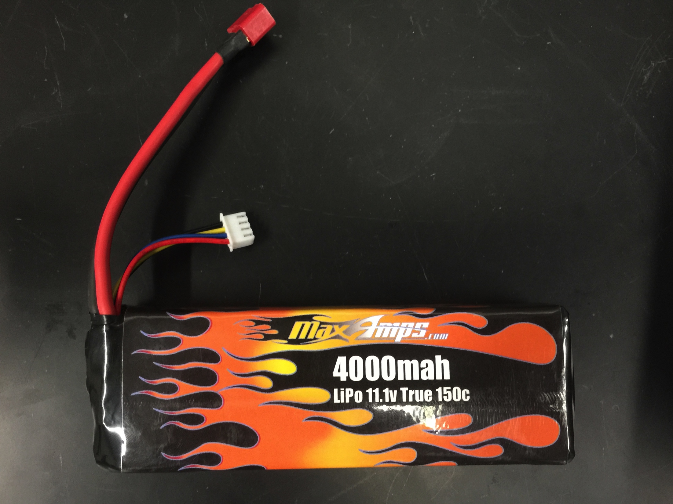
Check Functionality
Ensure Li-Po batteries remain the proper voltage

Slide 8
New Antenna
70CM J-pole, ladder line antenna
Often broken or damaged during flight

Slide 9
Repairs
Broken Connectors
Burnt out power regulators
Damaged GPS antenna

Slide 10
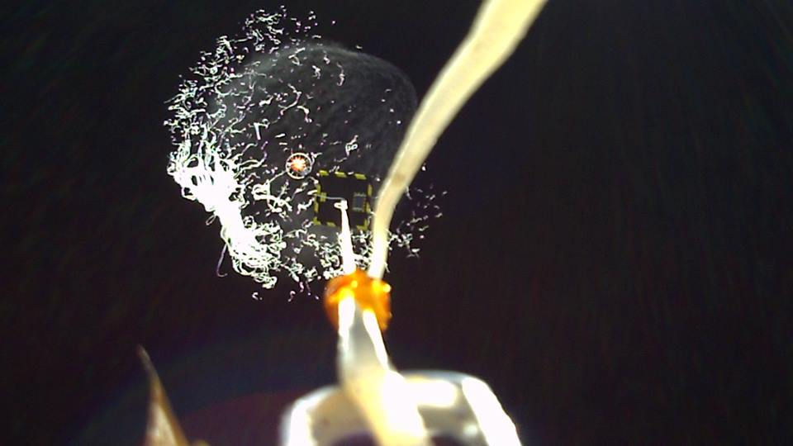
Questions?

